Slide 1
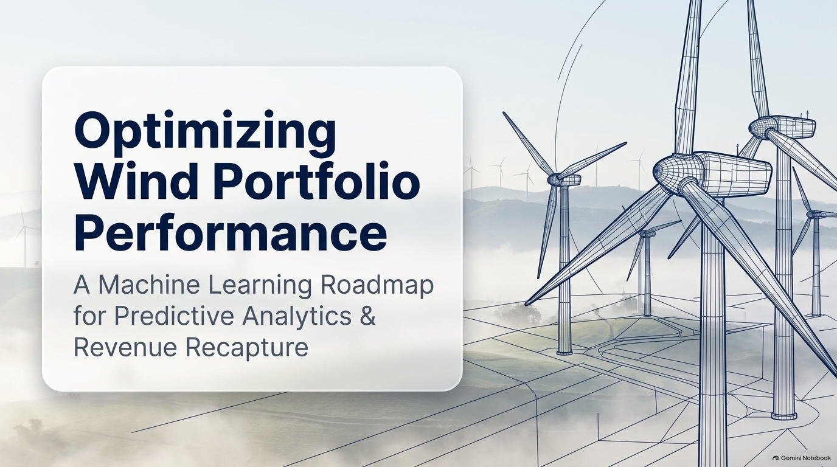
AI-Powered Predictive Analytics
& Revenue Recapture
An AI Solution for Predictive Analytics & Revenue Recapture

Slide 2
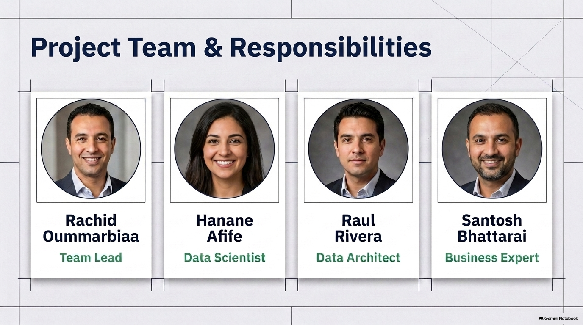

Slide 3
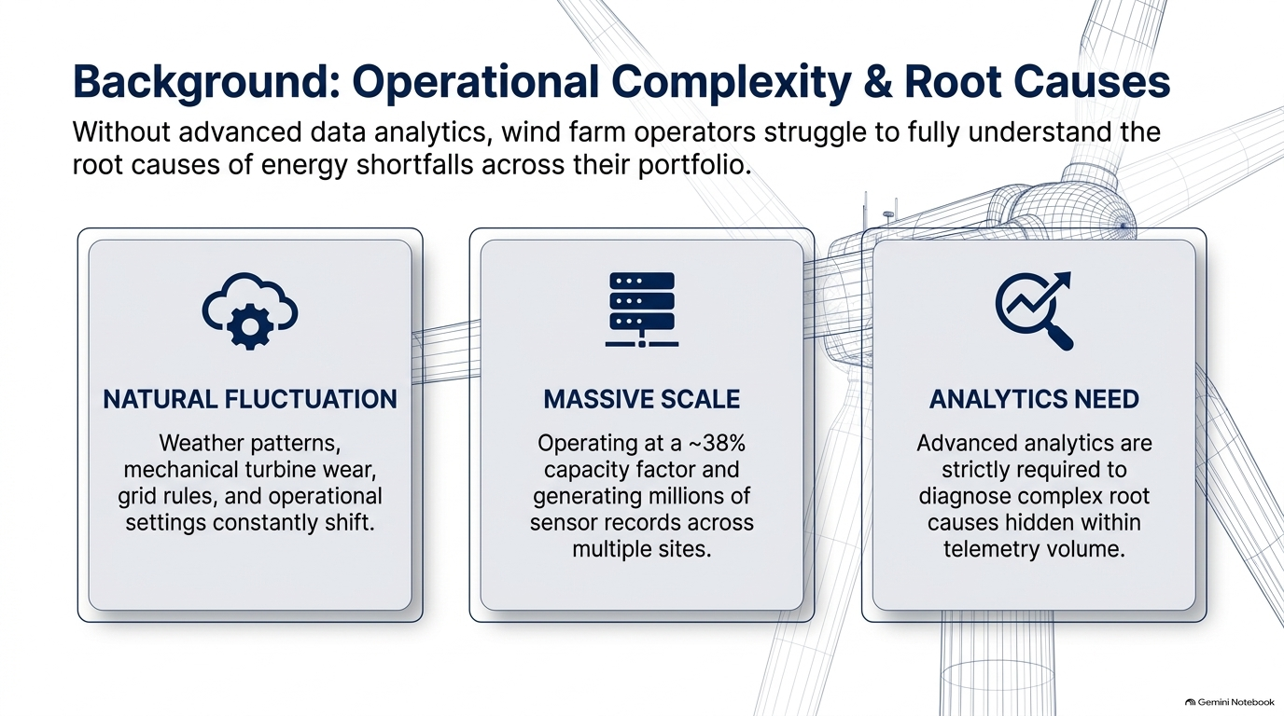
Wind turbine availability does not always translate into optimal energy production.
Turbines can remain operational while generating below their potential due to changing environmental, mechanical, operational, and grid conditions, creating performance losses that are difficult to detect through conventional reporting.
As ACWA rapidly expands its renewable portfolio, strengthening data visibility, predictive asset intelligence, and operational performance is increasingly important to maximizing energy generation and asset value. ACWA is already advancing this direction through IoT-connected plants, predictive maintenance, and AI-enabled operational analytics
The challenge is no longer just keeping turbines running, it is ensuring that every operating turbine generates as much energy as it should.

Slide 4
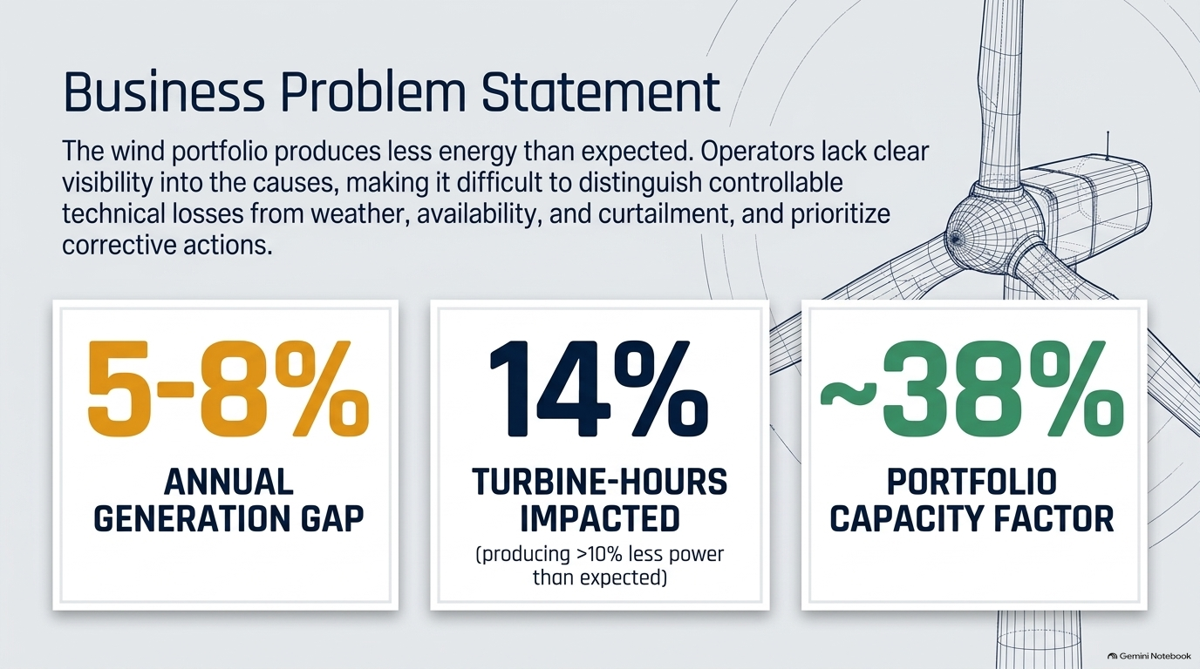

Slide 5
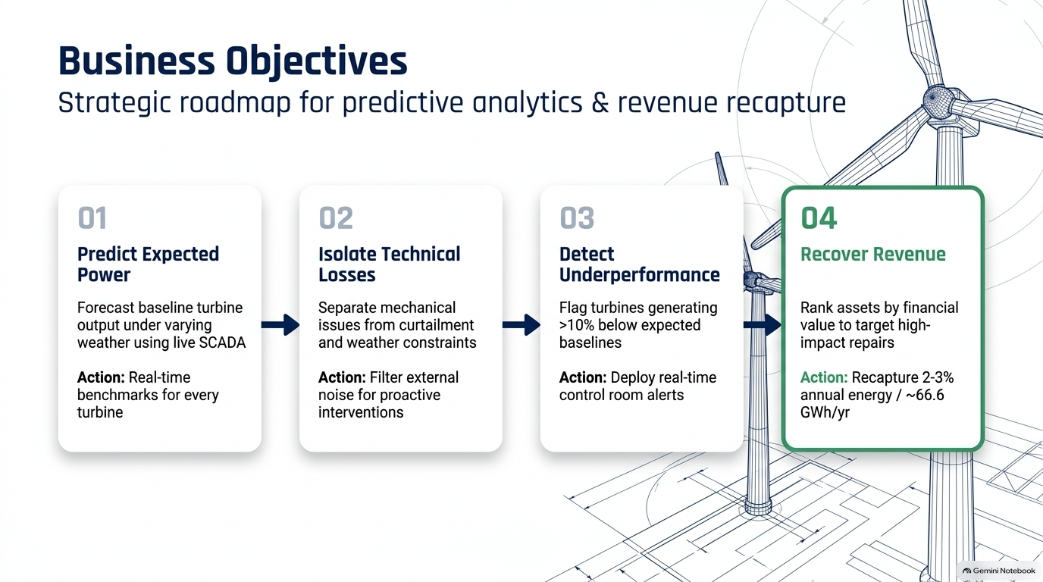

Slide 6
01
02
03
04
REDUCE
UNDERPERFORMANCE
QUANTIFY
LOSS EXPOSURE
IMPROVE
DETECTION RELIABILITY
RECOVER ENERGY
& BUSINESS VALUE
Identify turbine operating periods with
Quantify and attribute technical losses within
Estimate expected turbine power with
Enable recovery of
>10%
~14%
R² ≥ 0.90
2–3%
deviation below expected power
of operating hours showing underperformance*
model performance target
annual energy production • ≈66.6 GWh/year*

Slide 7
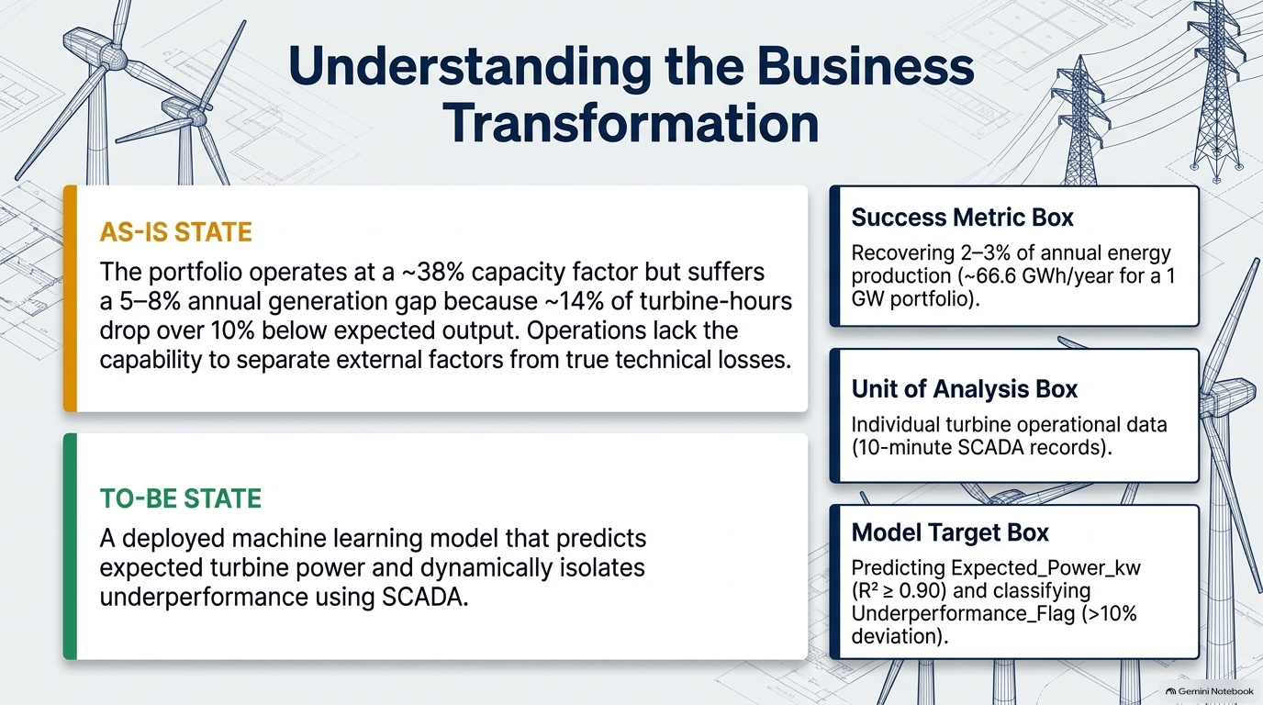

Slide 8
14% of operating hours show underperformance, but operations lacks sufficient visibility into which turbines are affected and how much energy is being lost.
AI Solution

Slide 9
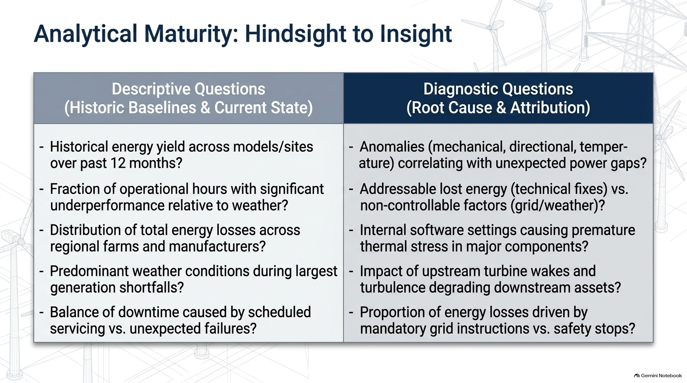

Slide 10
What happened
Why did it happen?
Which turbines are underperforming, and how frequently does underperformance occur?
Which turbines show the largest and most persistent gaps between actual and expected power generation?
Which farms, regions, site zones, and turbine models have the highest levels of underperformance??
How does turbine performance vary over time?
When and where are the largest power deviations observed?
Why are certain turbines consistently generating below their expected power?
What factors are driving the largest gaps between actual and expected power generation?
Why do some turbines underperform while comparable turbines operating under similar environmental conditions do not?
Are observed power shortfalls primarily explained by environmental conditions, operational constraints, or turbine condition?
What combinations of mechanical, thermal, operational, and environmental factors characterize persistent underperformance?

Slide 11
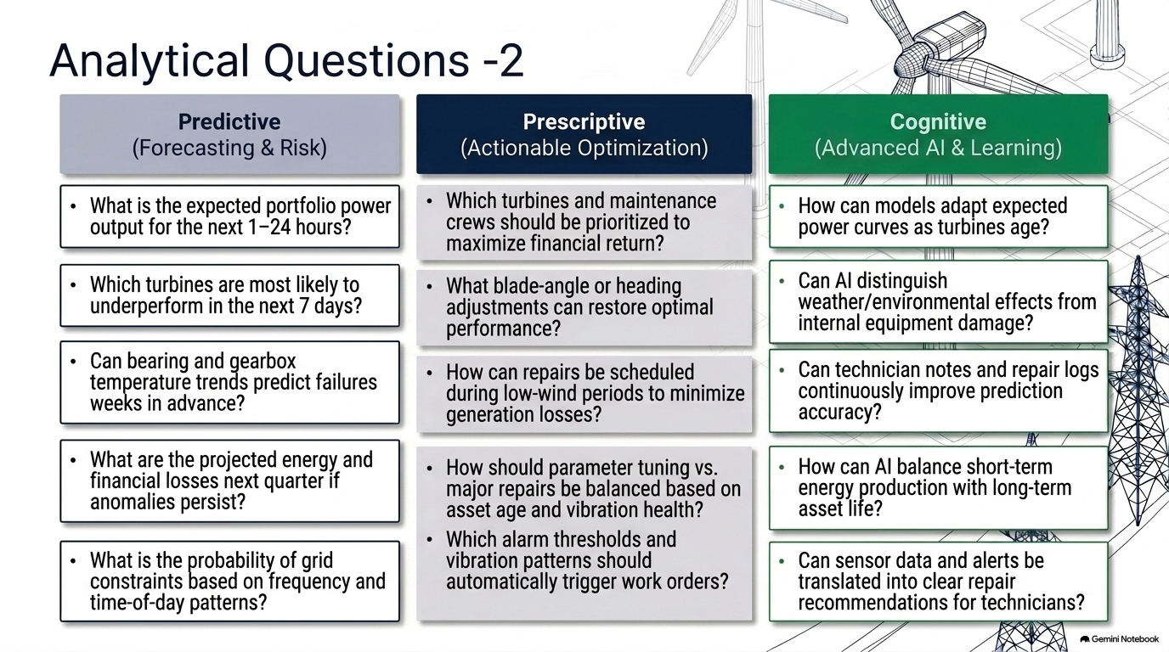
What is expected or likely to happen?
Which underperforming turbines should be prioritized for intervention?
When should operators intervene to minimize energy losses?
What intervention should be recommended for each type of underperformance?
How should maintenance resources be allocated across turbines to maximize recoverable energy?
Which intervention strategy provides the greatest expected energy recovery and business value?
Which turbines should be prioritized for intervention based on potential recoverable energy?
What intervention should be taken for each identified underperformance condition?
When is the optimal time to intervene to maximize energy recovery while minimizing operational disruption?
How should limited maintenance resources be allocated across turbines to maximize recoverable energy?
Which intervention strategy provides the best trade-off between energy recovery, maintenance cost, and operational impact?
How can AI adapt expected turbine performance as equipment ages and operating conditions change?
How can AI distinguish environmental effects from emerging equipment-related performance issues?
How can AI learn from technician feedback and maintenance history to continuously improve its understanding of turbine behavior?
How can AI discover new and previously unseen patterns across environmental, operational, mechanical, and thermal data?
How can AI translate complex sensor patterns into clear, explainable insights for operators and technicians?

Slide 12
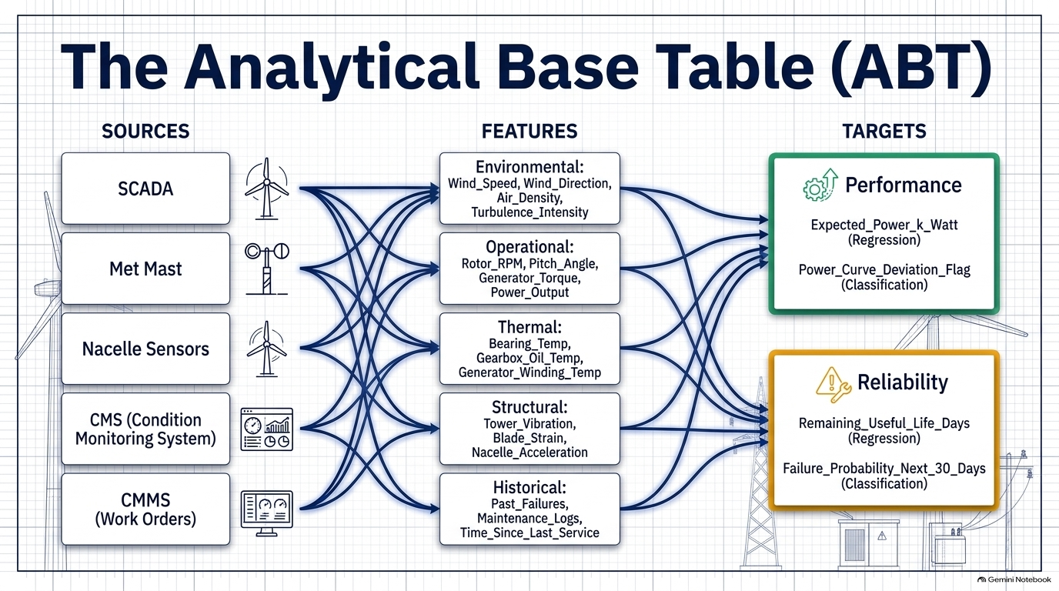
FEATURE SET
UNIT OF ANALYSIS
ANALYTICAL TARGETS
01
Environmental
TARGET 1
Wind • Turbulence • Air Conditions
Expected Power
02
Operational
Power • Rotor • Availability • Curtailment
Regression
03
Mechanical
Yaw • Drivetrain Vibration
TARGET 2
04
Thermal
WIND TURBINE
Underperformance
Gearbox Temperature
One turbine / operating interval
Asset & Time Context
Classification
05
Turbine • Model • Farm • Region • Timestamp

Slide 13
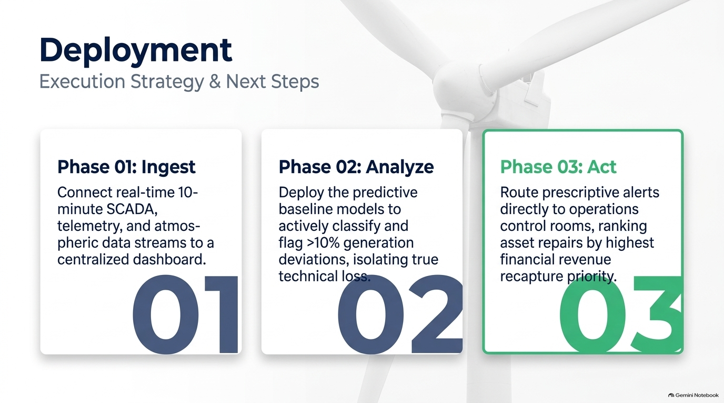

Slide 14
AI Solution Deployment & Operationalization
PROPOSED: HYBRID DEPLOYMENT
From turbine data to production AI, operational decisions and continuous improvement
Subject to IT/OT & cybersecurity approval
PRODUCTION ARCHITECTURE
TURBINE / SCADA
& SENSORS
CONNECTIVITY
INGEST &
PROCESS
DATA PLATFORM
AI ANALYTICS
OPERATIONAL USE
Operational + condition data
OPC-UA • MQTT • API*
Quality • Transform • Context
Historical + streaming data
Expected Power
Underperformance • Diagnostics
API • Dashboard • Alerts
O&M / Technician workflow
*Integration options shown; final protocols/platform depend on ACWA production standards.
Technician / maintenance outcomes → monitoring & learning
DEPLOYMENT LIFECYCLE & CONTROL
1
PREPARE
2
VALIDATE
3
DEPLOY
4
ADOPT
5
MONITOR
6
IMPROVE
Owner • SMEs • KPIs
Data & integration readiness
Model • Data • Security
User acceptance
Controlled release
Production integration
Training • Alerts
Escalation workflow
Accuracy • Drift • Data
System + business KPIs
Retrain • Revalidate
Redeploy / retire
BUSINESS READINESS & OWNERSHIP
WHAT WE NEED FROM THE BUSINESS
WHO OWNS WHAT
Business owner & SMEs • Production data access • KPI / acceptance thresholds
• Operational workflows • Alert & escalation rules • IT/OT & cyber requirements • User roles
• Training • Rollback authority
Sponsor — outcome & approval | O&M — operational validation & action | Data/AI — model & monitoring |
IT/OT/Cyber — platform, integration & security | Operators/Techs — use & feedback
MONITOR
Model performance • data quality • drift • pipeline/system health • alert quality • recoverable energy / business KPIs
ROLLBACK PLAN
Decision gate: Continue • Revalidate • Retrain • Redeploy • Retire
Trigger → restore last validated version → investigate → correct → revalidate → redeploy
Deployment success = production integration + business readiness + clear ownership + monitored performance + controlled recovery.

Slide 15


